Slide 1
Academy Lab Projects – Showcase
Ran Almagor
Roee Trebinovich
Michael Greenberg
Student Records Web Application on AWS
25.04.25
Notes:
For Educators: You can use this template to help your students effectively present and communicate their project to a broader audience. Your students can also use this presentation as a portfolio of their work to demonstrate their cloud skills.
The presentation structure is listed below. The total time may vary depending on the activity you want to conduct. For example, you may want your students to provide high-level walkthrough of their final solutions versus deep-dive into why or how they chose certain services and the steps of building their architectures.
Suggested timing for a 15-minute presentation:
Introduction – 30 seconds
Business scenario overview – 1 minute
Solution overview – 5 minutes
Architecture diagram of the solution – 2 minutes
Demo – 5 minutes
Lessons learned – 1.5 minutes

Slide 2
Business scenario overview
Problem
The admissions website slows down or crashes during peak times, frustrating users and delaying applications. Migrating to AWS offers a scalable, reliable solution.
Business Requirements
High availability
Auto scaling & load balancing
Secure & performant architecture
Cloud-based on AWS
Notes:
Define the problem or opportunity that you are addressing. Include pictures, figures, and statistics to help the audience better conceptualize the problem or opportunity.
Specify who your users or customers are and what pain points they are experiencing.
For example: “Users complain that the student admissions department website is too slow and isn’t always available.”
Also, list any specific business requirements that you are addressing.
For example: “Improve the experience for users. The web application can be deployed to the AWS Cloud. The application must be highly available, scalable, load balanced, secure, and performant architecture that can support thousands of users.“
Note:
An above-bar overview succinctly defines the problem and opportunity statement. For example: “Customers with media files, such as retail companies, need an easy and cost-effective way to analyze photos and videos of their inventory.”
A below-bar overview is too verbose, technical, or not specific. For example: “The most common media files are .jpg and .mp4. Companies have media files of their inventory.”

Slide 3
Solution overview
Deployed a student records web app to AWS for improved reliability and performance.
Used Auto Scaling and Load Balancer to handle peak traffic and ensure high availability.
RDS for secure database access, Secrets Manager for credentials, and EC2 for web servers.
Use cases: Students can view, add, edit, and delete records. Admins can manage application data.
Notes:
Explain at a high level what you have built.
For example: “I built a web application for a company to host their blog.“
Talk about why you chose certain parts of the solutions and any tradeoffs that you made. Focus on how you designed the solutions and how you applied the AWS Well-Architected Framework as part of the process (AWS Well-Architected Framework: https://docs.aws.amazon.com/wellarchitected/latest/framework/welcome.html).
For example: “I configured load balancers and auto scaling to make the application highly available and reliable.”
Include the use cases that you are addressing. Think about who your users are and how they would want to interact with your solution to solve their problem.
For example: “Users can view, upload, edit, and delete blog posts. Administrators can approve blog posts.”
Talk about the use cases that you addressed as part of the minimum viable product (MVP) that you scoped and built.
Note:
An above-bar description is concise and includes the most important benefits. For example: “The solution allows customers to quickly upload, store, and search large catalogs of images and videos in Amazon S3.”
A below-bar description is too detailed or not specific. For example: “Our solution analyzes media files.”

Slide 4
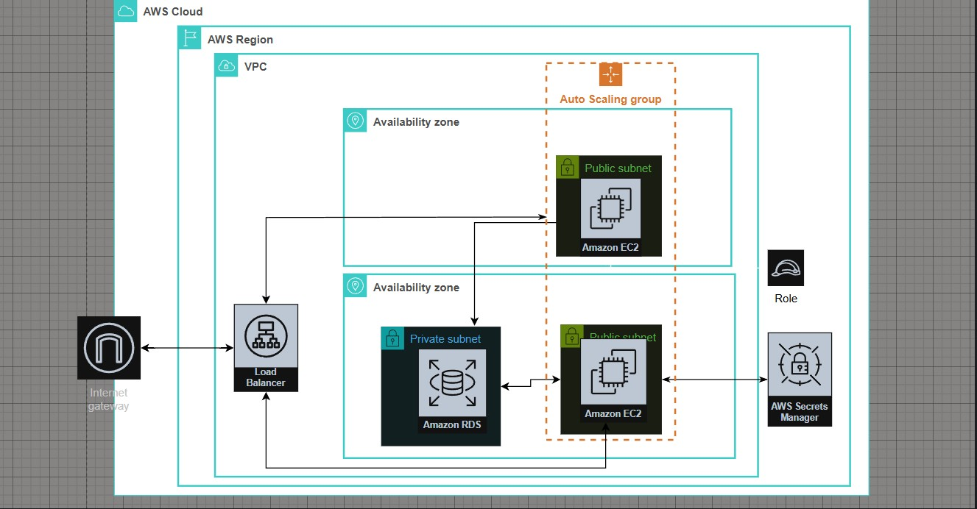
Architecture diagram of the solution
Notes:
Use the following resources to create a diagram of your application architecture:
AWS Architecture Icons at https://aws.amazon.com/architecture/icons. This page includes diagram assets as well as links to drawing and diagramming tools that you can use.
As you walk through the architecture, make sure that you relate back to the business requirements and the AWS Well-Architected Framework (https://docs.aws.amazon.com/wellarchitected/latest/framework/welcome.html).
You can also go more in depth about the design considerations and trade-offs that you made.

Slide 5
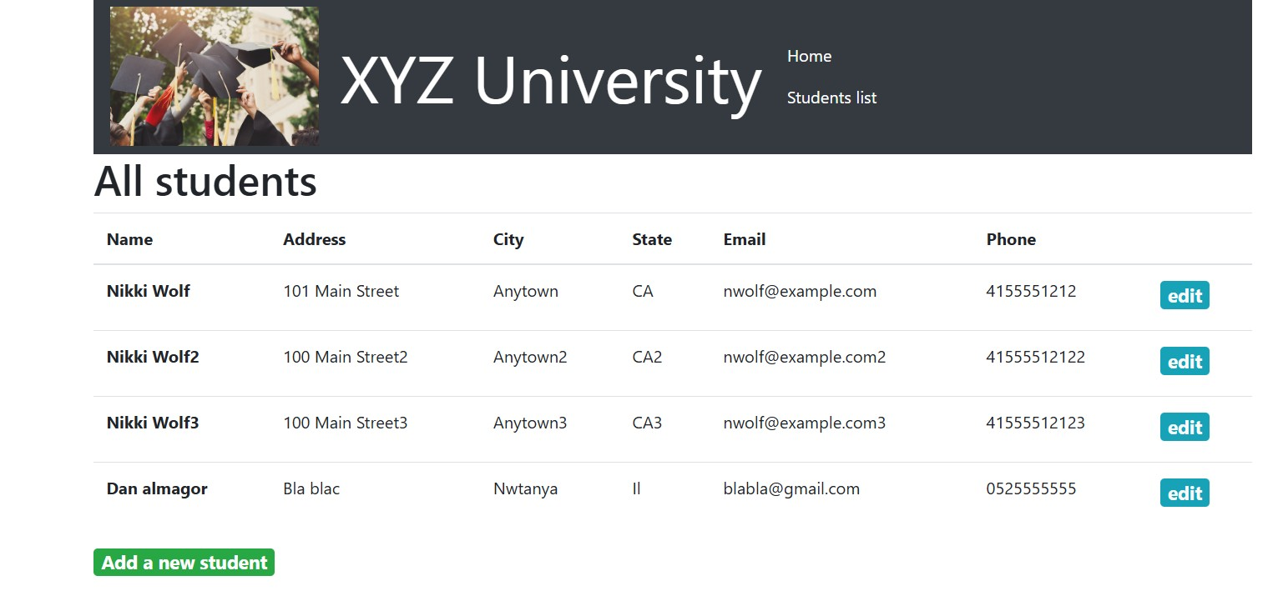
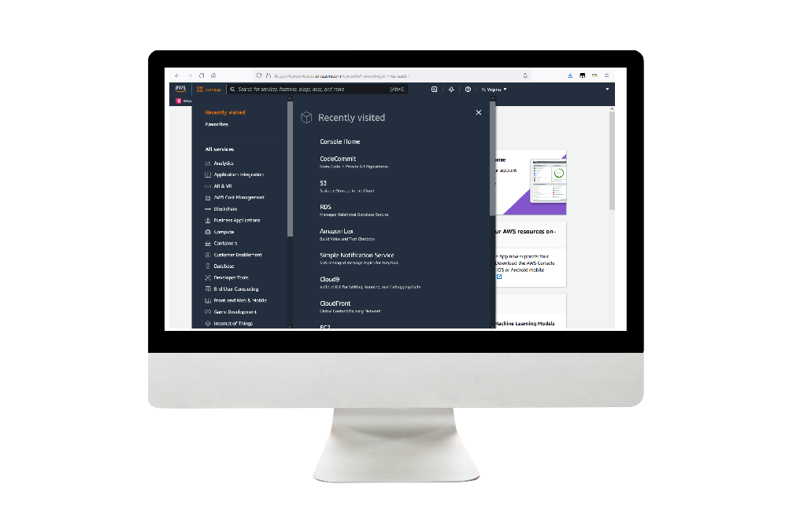
Demo
Notes:
For the demo, guide the audience through the two to three most important benefits of the solution and how it addresses the requirements.
Your demo materials can be screen captures, recordings, a link to your final solution, and/or a link to AWS console.

Slide 6
Lessons learned
Faced challenges setting up Auto Scaling and EC2 permissions, solved using AWS documentation.
Used AWS Architecture Icons and Pricing Calculator as key resources.
Gained hands-on experience with load balancers, security groups, and EC2 launch templates.
Next step: extend the solution to support multi-department access and HTTPS integration
Notes:
Describe any challenges that you encountered and how you overcame those challenges.
For example: “I got stuck when I was creating an EC2 instance to host the application. I used the resources that were listed in the instructions to walk myself through the process to create a new EC2, and I was able to complete the task. The links to labs in other courses were very helpful.”
Describe any new skills that you learned from this project.
For example: “I learned how to set up auto scaling correctly so my resources were automatically adjusted and allocated at the lowest possible cost.”
Discuss any future, out-of-scope use cases in the next steps.
For example: “I would like to scale out the web application so that multiple departments can use it.”

Slide 7
Thank you

